Slide 1
Progress Report
Cs461 Senior Capstone
vISA Communication tool-----group 64(Wenbo hou)

Slide 2
Project Overview
Project Purposes
Current VISA communication application is not effective
Clunky Interface
Limited Functionality
Unsatisfying Documentation

Slide 3
Project Overview
Project Goal
New VISA communication tool with
Graphic User Interface
Communication layer
Code Auto-completion & Query Tool
File I/O
Instruments Detective and Identification

Slide 4
Preparation
Target problems
Specify Requirements
Assign Requirements to team members
Research relate technologies
General Design

Slide 5
Target problems & Specify Requirements
Remote Conferences with clients
Discuss drawbacks of current software
Specify requirements
Clarify abstract concepts

Slide 6
Responsibilities
Code Auto-completion
Query Tool
Device Identification

Slide 7
Technologies
Intellisence
CSV & querycsv.py
PyVISA.py

Slide 8
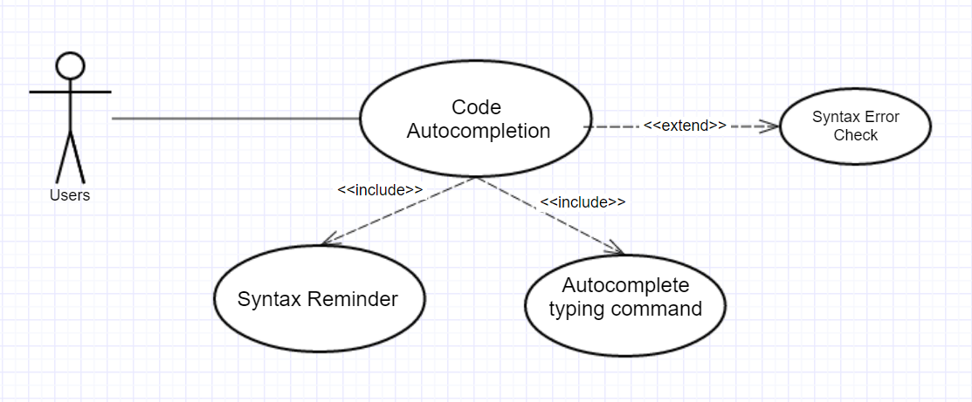
Code Auto-completion

Slide 9
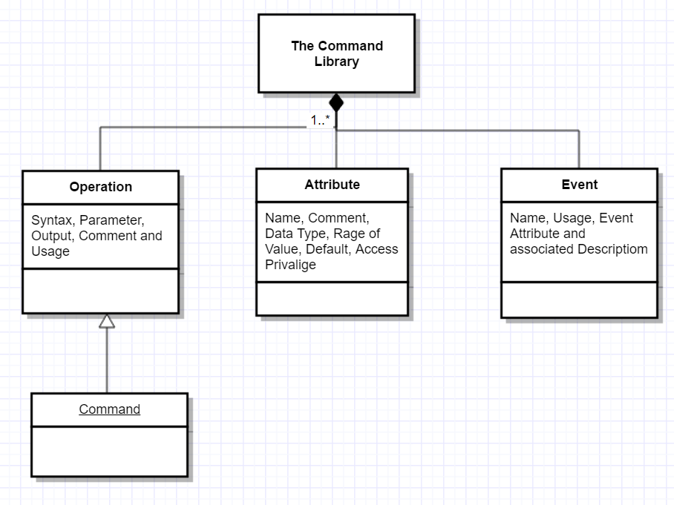
Documentation

Slide 10
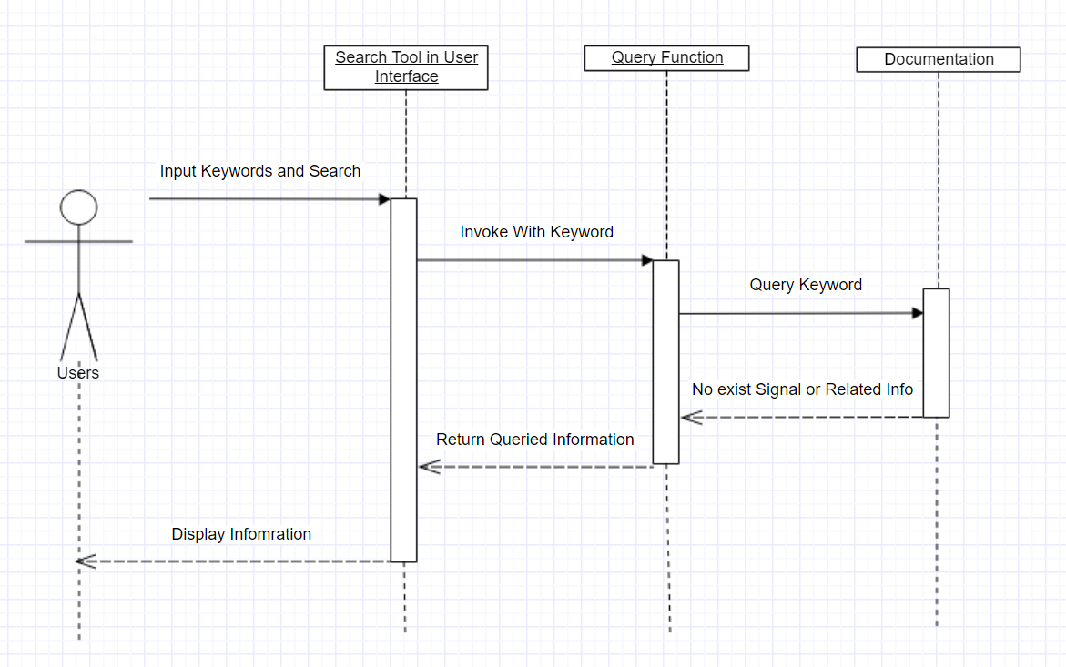
Query Tool

Slide 11
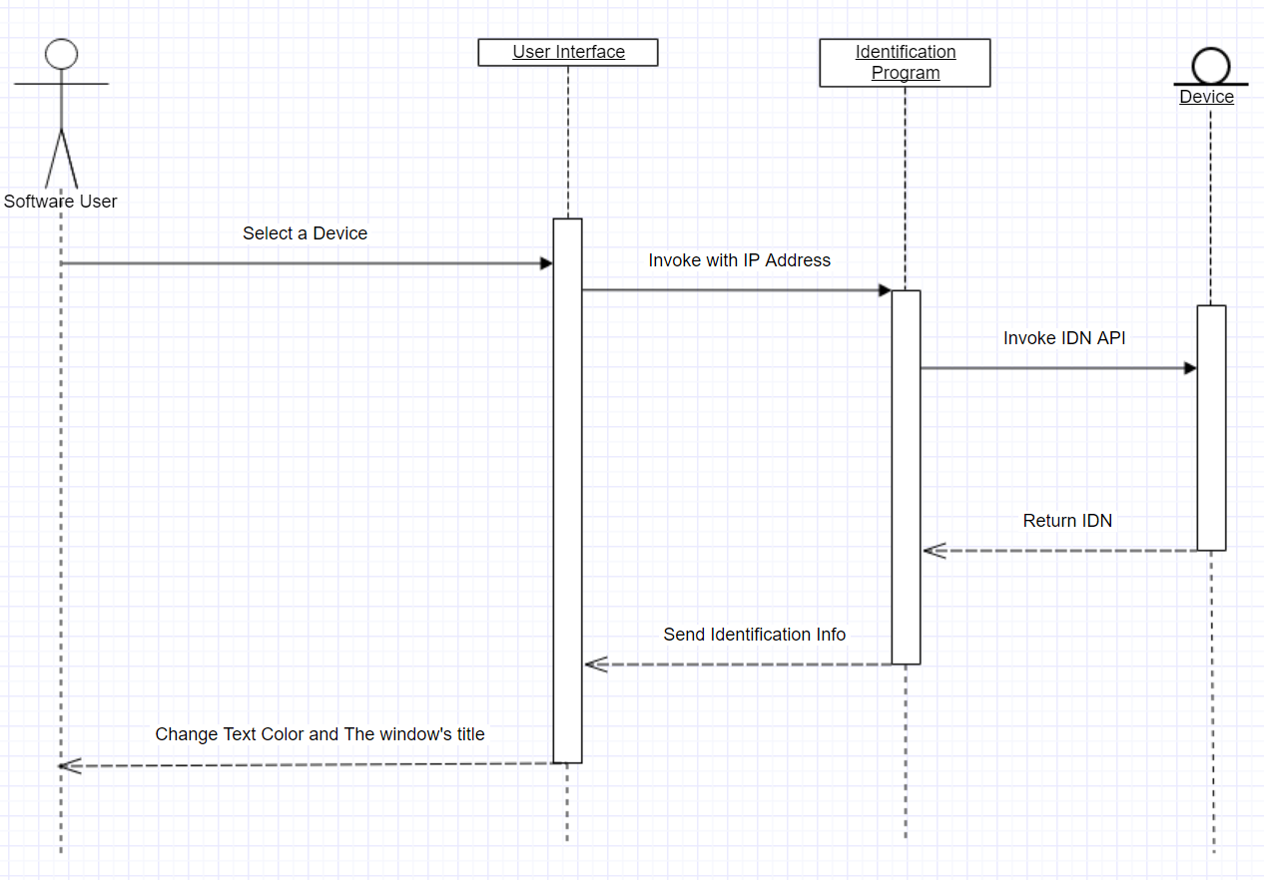
Device Indentification

Slide 12
Others
Solve Time conflict
determine concurrent work platform
Ask help from Kristen about documentation grammar/ format issues
Ask help from Nels about technical issues
Summarize Weekly progress

Slide 13
Presentation Python Based VISA Communication Tool
Group 64-Fall Term16
Chenliang Wang

Slide 14
Three aspects
Provides a detailed overview of the design and goals of our project.
Discusses any stumbling blocks we are run into and how we overcame them.
Includes project details as described above for document.

Slide 15
Overview
Old VCT is hard to use, we need create new VCT easily, quickly, friendly for Tektronix.
New VCT
User interface
Internet connection
Functions
3 terms (9 months)
Design (Fall)
Implement (Winter)
test, fix, expo (Spring)

Slide 16
Stumbling blocks
English writing skill.
---Get help from OSU writing center.
New skill of implement the project.
---Research online, Get help from TA.

Slide 17
Project details
Problem Statement
Blog
Requirements document
Technology review
Design document
Progress report

Slide 18
3 Pieces of Project
User Interface design
---Balsamiq Mockups
User Interface framework
---Pyqt
Function testing
---Unit testing

Slide 19
Conclusion

